Slide 1
2/20/19 Progress Report
Transition Period Still

Slide 2
Agenda
Progress
Next steps
Miscellaneous

Slide 3
Progress

Slide 4
Preparing to Test PCBs
MacroFab delayed shipment of processor and comms board
Hopefully ready by Friday
Power is a little behind the others, but mama didn’t raise no bitch
Working on comms code - Nathaniel
Successful data transmission!
Working on cleaning up the code for what we need for showcase.
Integrating particulate/UART code - Robyn, Rachel
As we said, UART works
Now, implement it in our prototypes
Working on fuel gauge code - Brady
I have writer’s block… debugger’s block?... I’m stuck

Slide 5
Prototype #3
Currently trying to reduce sizes of all boards
Goal of 35 mm by 40 mm
New features?
Mechanical connectors
Either actual LEGOs or simple plastic feet
2 Processing/Sensor Boards
Accelerometer and Temperature
Plan is to order before Spring Break
Half of team is working on Prototype 3, half of team is working on code, all of team will work on putting together prototype 2 upon arrival
Sensor/Processor Board already finished
https://factory.macrofab.com/pcb/8gn1jty/1/design

Slide 6
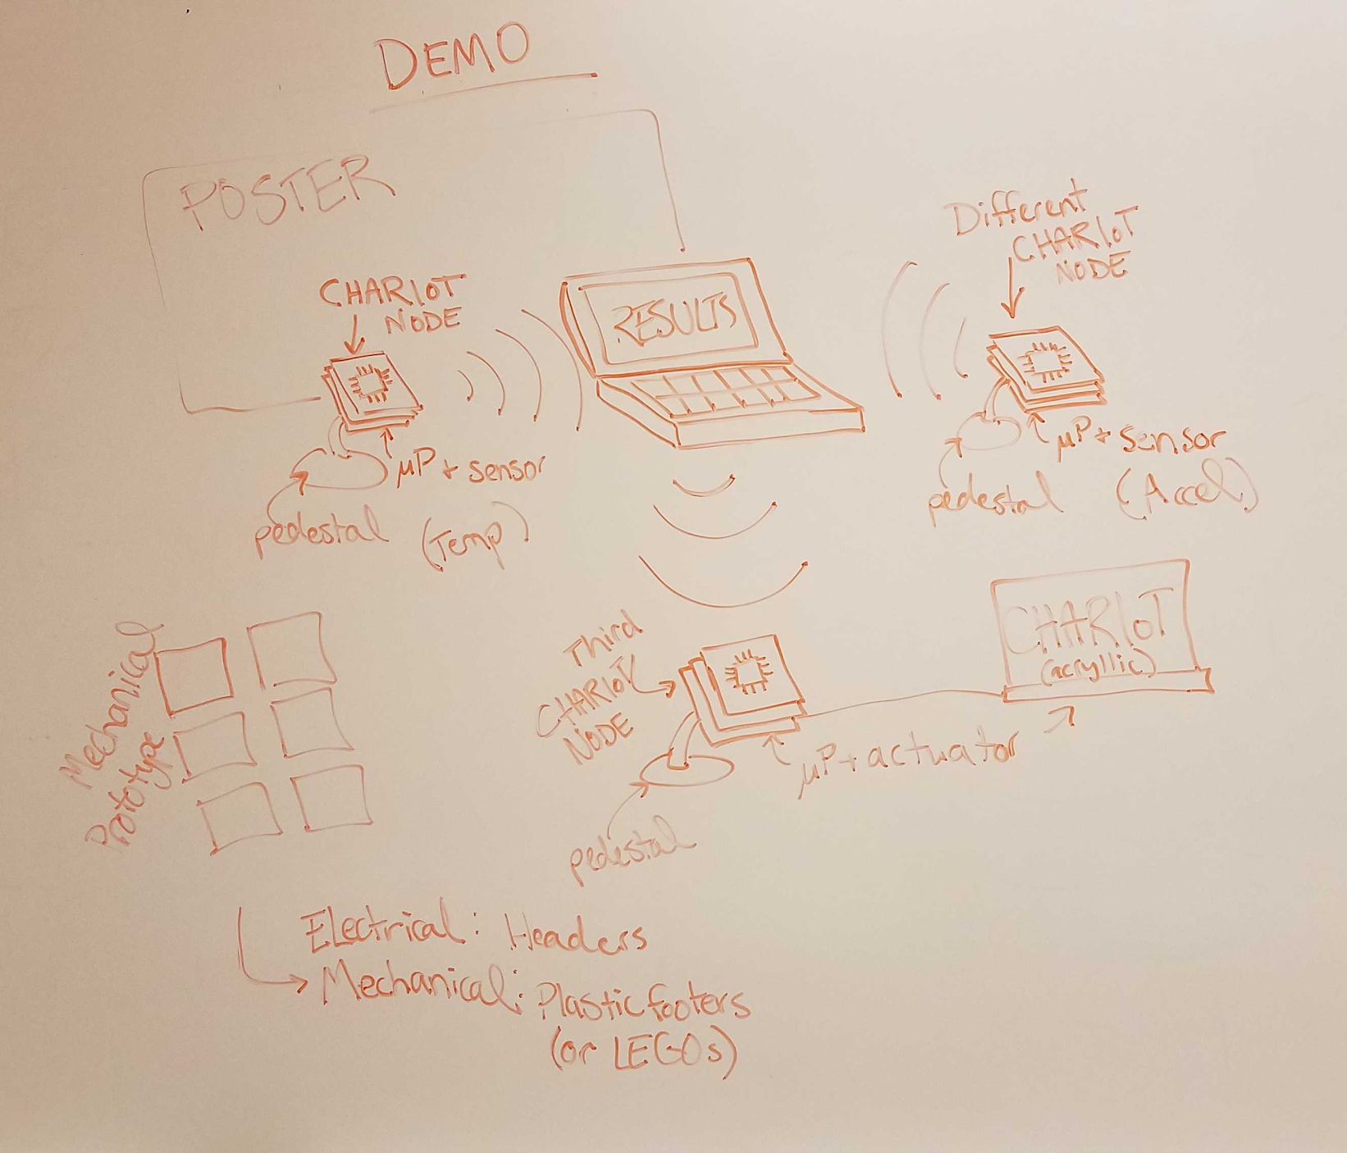
Demo
Hope to have 3 CHARIoT nodes communicating with a laptop or tablet
1 node measures temp, 1 node measures acceleration, laptop collects measurements and sends to node 3, which controls the color of a fancy acrylic CHARIoT sign
fancy pedestals for the nodes, mechanical prototypes to show how they connect together, and a poster
Affiliates’ Day?

Slide 7
Action Items

Slide 8
Action Items
Continue to work on code
Begin assembly this weekend
Prepare for Prototype #3 design in parallel
Finalize Cycle 3 and Demo
Decide down the line between paper or competition

Slide 9
Miscellaneous

